Slide 1
POSTURE SENSEII
A project by:
Basil George Poulose : 1761002
Nikhil Niranjan: 1761020
Karthik Krishna: 1760641

Slide 2
What it's About:
Poor sitting posture is believed to be a major contributor to low-back pain and isn't good for your back either.
Good posture is very important in a positive way. Improves your appearance and helps you project self-confidence and self-assurance.
To help resolve the back problems that affect most of the popuation of this century and to help everyone have a healthy lifestyle.
This projects presents us with a wearable device on your back and it’s function is to detect changes in your posture and alerts the user accordingly using the the buzzer on the device and the Dabble app used in the phone which gives us a notification.

Slide 3
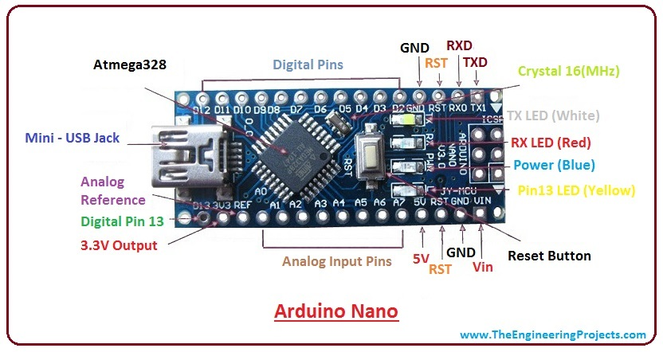
Pin Diagram:

Slide 4
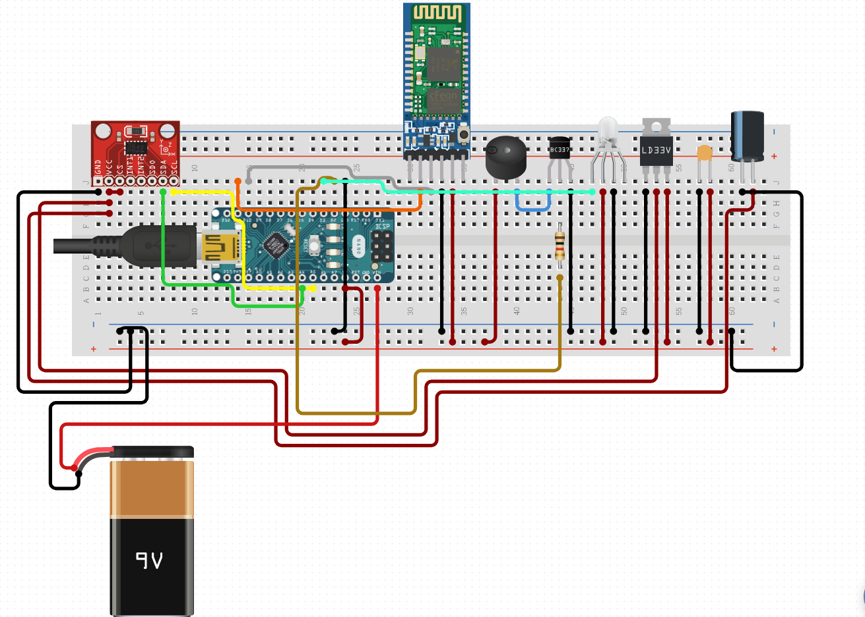
Connections:

Slide 5
No. | ARDUINO NANO | ADXL 345 | BLE HC-05 | LED | BUZZER
1) | A4 | SDA | - | - | -
2) | A5 | SCL | - | - | -
3) | D2 | - | TXD | - | -
4) | D3 | - | RXD | - | -
5) | D13 | - | - | Positive | -
6) | 5V | VCC | VCC0) | - | -
7) | GND | GND | GND | - | Negative
8) | - | - | - | Negative | Positive

Slide 6
How it works:
For simple functioning of the Posture Senseii, all the components were assembled onto the breadboard and stuck to the subject’s back tightly.
To begin the testing of the device, we first connect it to our mobile phones using the Bluetooth module on the breadboard.
When the subject slouches to a certain degree which was bad for his/her spine, a notification is sent to the subject's phone and alerted by the buzzer.

